Slide 1
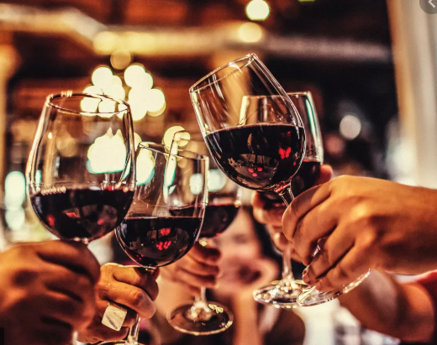
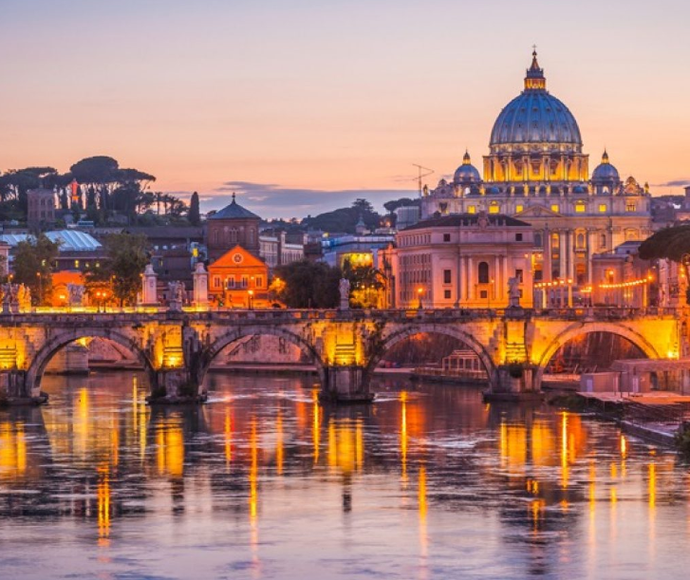
Opening a new wine bar 🍷 🥂 in Rome, Italy
Source : Vox
IBM Project Capstone
April 2020
Lucia Casucci
Source https://www.artviva.com/

Slide 2
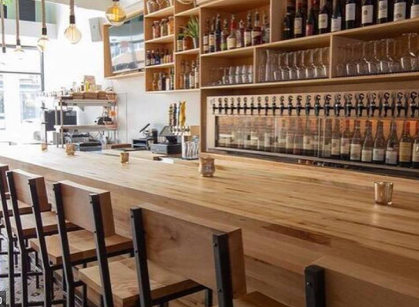
Business Problem Description
Rome is the capital city and a special jurisdiction of Italy with 2,9 Million residents.
In 2019, Rome was the 11th most visited city in the world, third most visited in the European Union, and the most popular tourist destination in Italy.
The goal of this study is finding out what is the best 3 locations to open a modern wine bar in Rome.
In order to do that, I will explore, segment, and cluster the neighborhoods in the city and analyze their venue types and distribution.
Source :wcpo.com

Slide 3
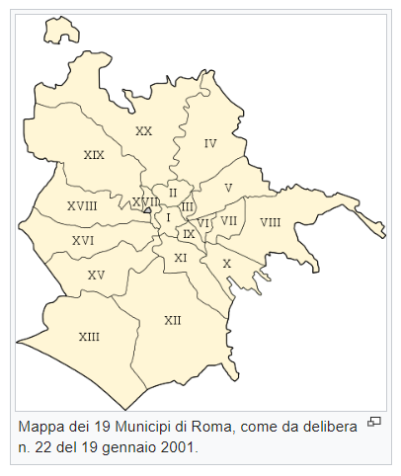
Data Sources
Source: Wikipedia.com
For the Rome neighborhood data, a Wikipedia page exists that has all the information we need to explore and cluster the neighborhoods (that are named in Italian Municipi) in the capital of Italy (https://it.wikipedia.org/wiki/Municipi_di_Roma).
Addresses will be converted into their equivalent latitude and longitude values using the geocoder library
I will use the Foursquare API (https://developer.foursquare.com/docs) to explore neighborhoods in Rome. I will use the explore function to get the most common venue categories in each neighborhood, check out their ratings, and the overall count of venues to understand the traffic.
I will use a KNN algorithm to cluster the neighborhoods to have a more general views of the city areas
I will use the Folium library to visualize the neighborhoods in Rome and their emerging clusters, and identify the best one to open a modern wine bar.

Slide 4
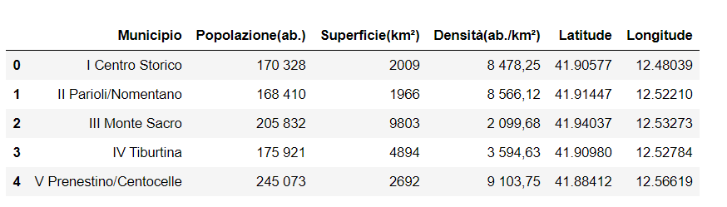
Methodology
Using beautiful soup library for python, I was able to extract the Wikipedia page with the relevant data and information about the Neighborhoods in Rome. The Wikipedia page had some information on the population, surface area, and director of each jurisdiction.
I used the python library geocoder to retrieve the latitude and longitude for each of these neighborhoods.
Neighborhood | Population (in thousands) | Area (in km^2) | Density (k people/km^2)
I Centro Storico | 170 | 20.00 | 8.50
II Parioli/Nomentano | 168 | 20.00 | 8.40
III Monte Sacro | 206 | 98.00 | 2.10
IV Tiburtina | 176 | 49.00 | 3.59
V Prenestino/Centocelle | 245 | 27.00 | 9.07
VI Roma delle Torri | 258 | 114.00 | 2.26
VII Appio-Latino/Tuscolana/Cinecittà | 307 | 46.00 | 6.67
VIII Appia Antica | 131 | 47.00 | 2.79
IX Eur | 184 | 183.00 | 1.01
X Ostia/Acilia | 232 | 151.00 | 1.54
XI Arvalia/Portuense | 156 | 72.00 | 2.17
XII Monte Verde | 141 | 73.00 | 1.93
XIII Aurelia | 134 | 64.00 | 2.09
XIV Monte Mario | 192 | 134.00 | 1.43
XV Cassia/Flaminia | 161 | 187.00 | 0.86

Slide 5
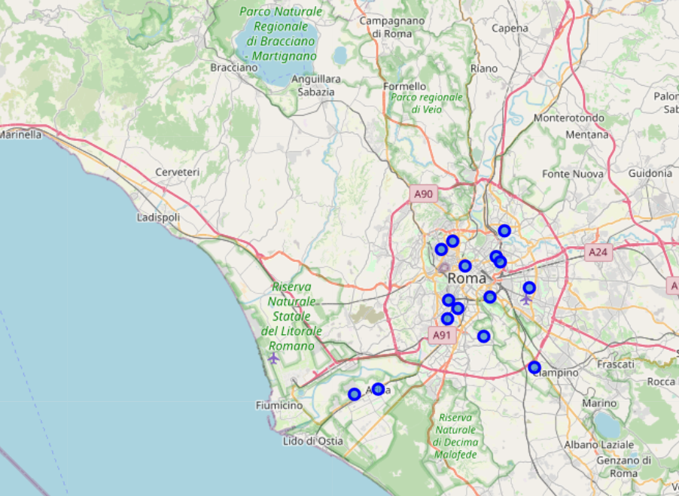
Methodology
With the help of the folium library, I was able to plot each neighborhood as a mark to visualize the overall distribution in the city map.

Slide 6
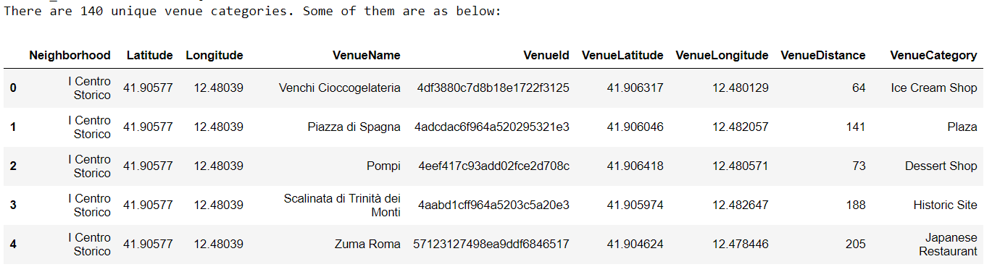
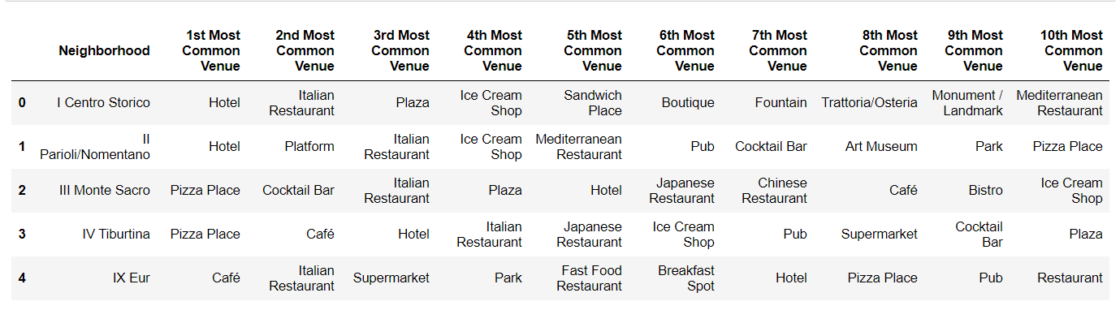
Methodology
By using the foursquare command to get at the most 100 venues per neighborhood, a dataframe listing their names, their distance by the neighborhood center, and their category was obtained. The 10 most popular venues per neighborhood were obtained as well.

Slide 7
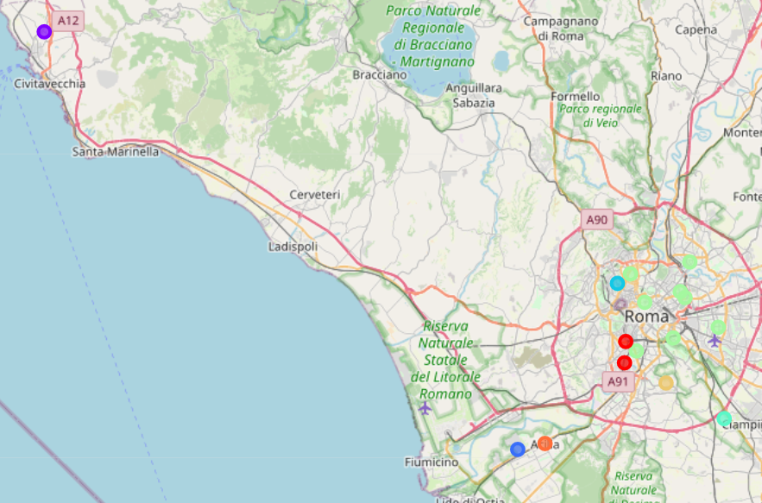
Methodology
A KNN algorithm with a number of clusters equal to 8 (optimal number) was run to group the city neighborhoods together, and the result was plotted using folium.
Neighborhood | Cluster
I Centro Storico | 5
II Parioli/Nomentano | 5
III Monte Sacro | 5
IV Tiburtina | 5
V Prenestino/Centocelle | 5
VI Roma delle Torri | 5
VII Appio-Latino/Tuscolana/Cinecittà | 5
VIII Appia Antica | 4
IX Eur | 6
X Ostia/Acilia | 7
XI Arvalia/Portuense | 1
XII Monte Verde | 0
XIII Aurelia | 3
XIV Monte Mario | 5
XV Cassia/Flaminia | 2

Slide 8
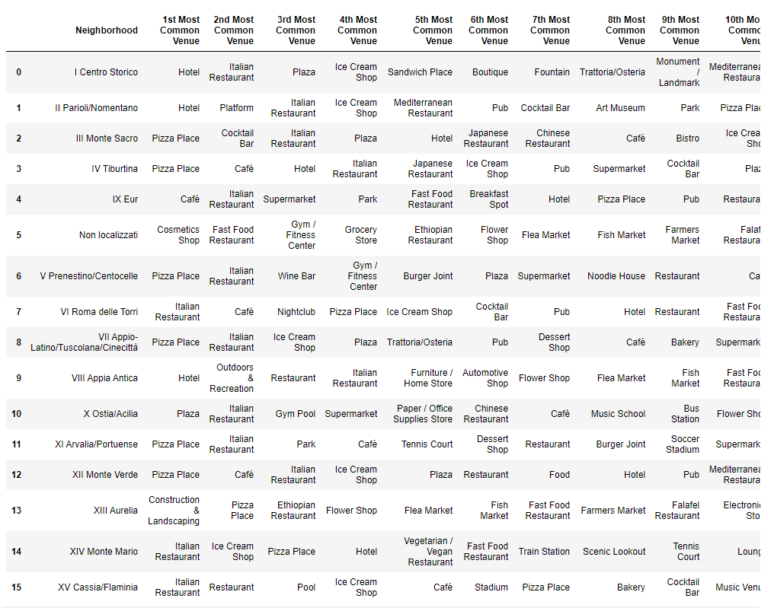
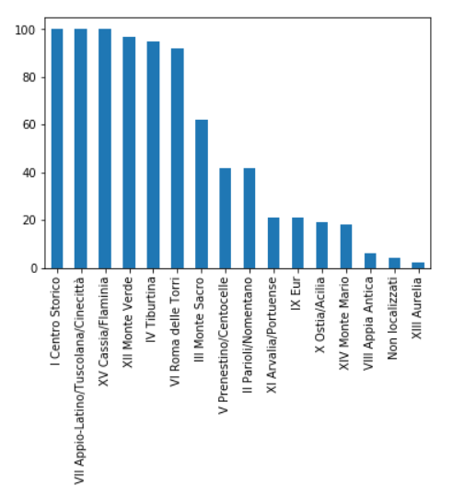
Results – neighborhood level
10 Most common venues per neighborhood
Count of venues by neighborhood
80% of the venues are concentrated in 6 neighborhoods. From this it is possible to infer that these neighborhoods have a higher traffic and flux of people than the others.
Appio Latino/Tuscolana/Cinecitta’ has the highest count of habitants
Centro Storico, Parioli and Appio/Latino/Tuscolana/Cinecitta’ have some of the highest population density of the dataset.
A high population density suggests a higher potential for traffic in a newly opened venue.

Slide 9
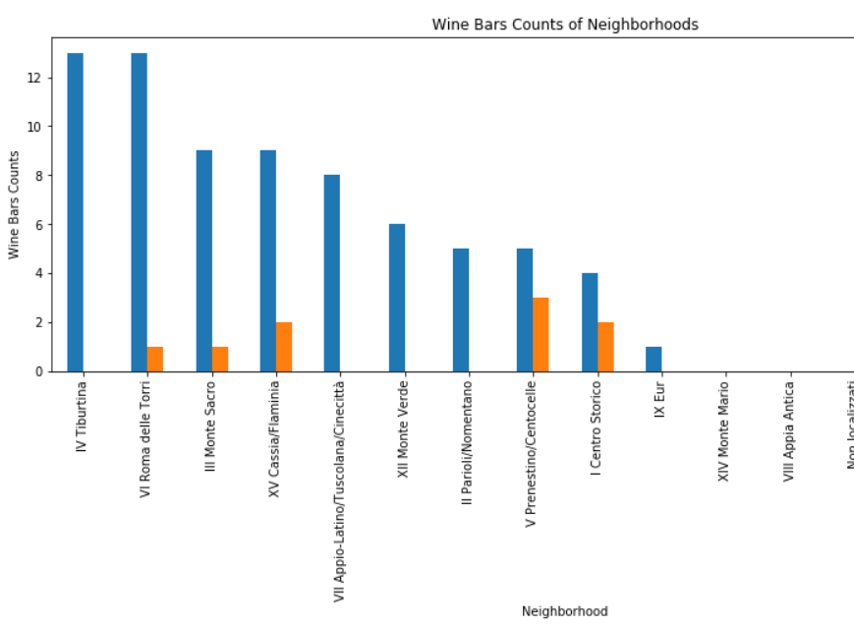
Results – neighborhood level
It is imperative to check how many wine bars and late night drink venues (like cocktail bars, wine bars, happy hour venues, pubs) are located in each neighborhood and in the city as a whole. People that are looking for grabbing a drink might be targeting this type of places, and it is important to make sure that our venue will not be in an area where a lot of other type of late-night drinks are already up and running.
The total number of bars in the dataset is 71 and only 13% of them are wine bars.

Slide 10
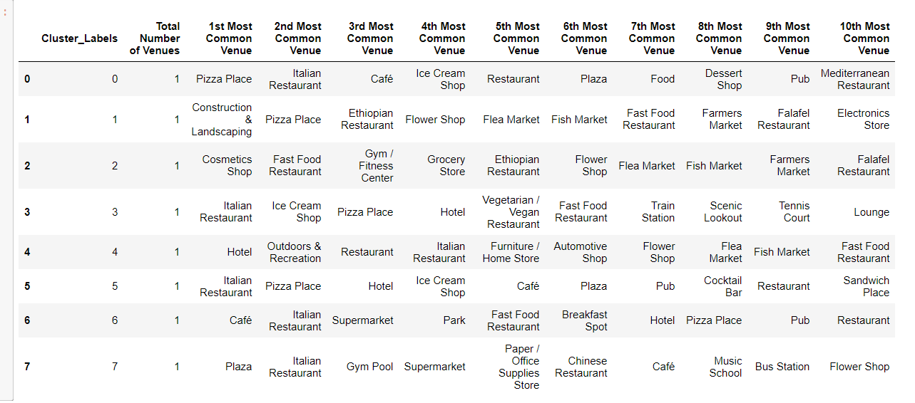
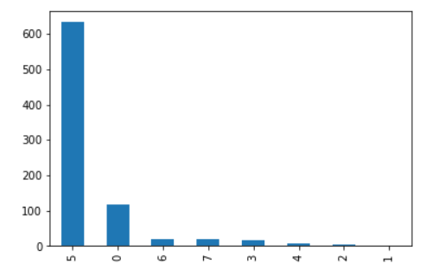
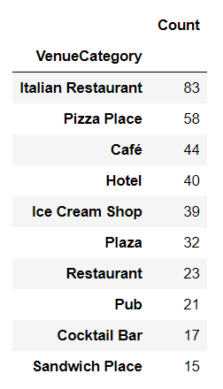
Results – cluster level
10 Most common venues per cluster
Count of venues by cluster
Highest Count venues
Demographics per cluster
Cluster | Population in thousands | Area in km^2 | Density (k people/km^2)
0 | 141 | 73 | 0.52
2 | 161 | 187 | 1.16
3 | 134 | 64 | 0.48
4 | 131 | 47 | 0.36
5 | 1722 | 508 | 0.30
6 | 184 | 183 | 0.99
7 | 232 | 151 | 0.65
1 | 156 | 72 | 0.46
Cluster 5 Is by far the biggest by population count and by surface area, and it corresponds to majority of the city center (75% of the total dataset number of venues)
Cluster 6 and cluster 2 have by far the highest population density.
Italian restaurants, pizza places, cafes, and ice cream shops are the most common venues across the whole city.

Slide 11
Discussion and Conclusion
Cluster 5’s Appia/Tuscolana/Cinecitta’ is the top option to open a wine bar in Rome. It has the highest population count and one of the highest densities of the whole dataset. Therefore, there is a higher potential for locals to visit the wine bar. It has the highest count of venues and majority of the top 10 are food joints, indicating a high traffic and people going there to hangout and eat. There is no wine bar yet, even though there are some late-night drink options.
Monte Verde (cluster 0) is one of the neighborhoods with the biggest count of venues and therefore high traffic. Since its population density and count is within the average of the dataset, most likely a lot of people gather or go there to visit its restaurants and venue. It is possible to see that its top venues are restaurants and food joints. It has no wine bars yet, and there are relatively little other late-night drink options compared to the other neighborhoods.
Cluster 5’s neighborhood Tiburtina is the third top option to open a wine bar. It has the one of highest counts of venues with a lot of the top 10 venues being food joints. It does not have a wine bar yet. Like Monte Verde, its population density and count are within the average of the dataset, so most likely a lot of people gather or go there to visit its restaurants and venue. However, it has 12 late-night drinks venues, double the ones of Monte Verde.
The next steps to select the top place to open our venue would be considering some socio-economic factors of these three neighborhoods, such as the cost of renting a space to convert a wine bar in those areas, as well as the age and income distribution of the people that usually visit their venues.

